Slide 1
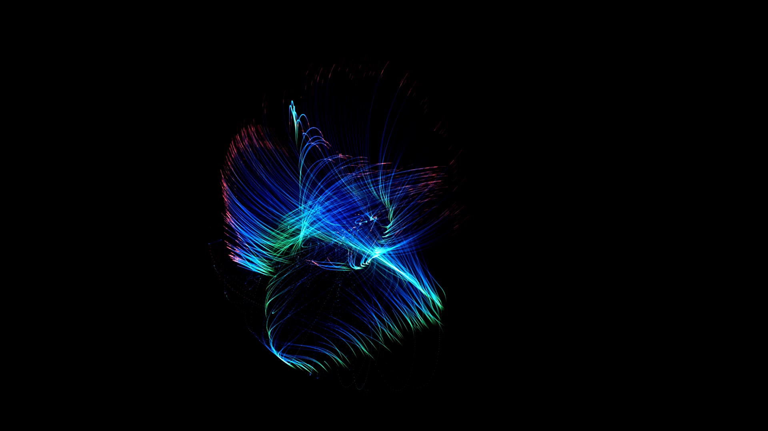
Team OTAVA

Slide 2
Origin

Slide 3
About the Project
This project is a real-life model of the solar system of all the planets up to Saturn
The mechanism of the gears dictate how fast each planet should move to simulate the actual time for each planet to revolve around the Sun

Slide 4
Contributions

